Slide 1
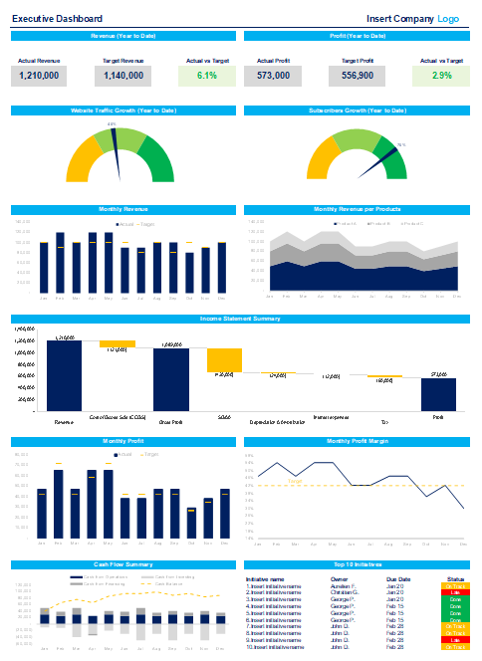

Slide 2


Executive Dashboard Toolkit
Overview & Approach

Slide 3


Introduction
This Executive Dashboard Toolkit was created by ex-McKinsey, Deloitte & BCG Management Consultants, and JP Morgan Investment Bankers. It includes all the Excel and Powerpoint dashboards required to monitor and optimize the performance of any organization, function, team, investment portfolio or project, regardless of size. Spend few minutes copying and pasting your data, and watch as all the charts, graphs, financial models and tables update automatically.
Join the 200,000+ Executives, Consultants & Entrepreneurs who are already leveraging our Management Consulting Toolkits to improve the performance of their organization and boost their own career.
If you have any questions, send us an email at support@domontconsulting.com and one of our ex-McKinsey, Deloitte & BCG Management Consultants will get back to you within 2 business days.
Aurelien Domont
Management Consultant
Domont Consulting Managing Director

Slide 4
Our Toolkit will help you fulfill multiple objectives
The Executive Dashboard Toolkit includes frameworks, tools, templates, tutorials, real-life examples, video training, and best practices to help you:
Monitor and optimize the performance of any organization, function, team, investment portfolio or project, regardless of size
Visualize your key performance indicators: revenue, profit, profit margin, product revenue, costs, cash flows, top initiatives status, etc.
Customize the dashboards to include the key performance indicators specific to your organization.
Present to your executive committee, board of directors, or potential investors world-class charts, graphs and tables: Waterfall charts, Gauge charts, Combo charts merging 2 types of charts in one, conditional formatting with different colours based on performance, etc.

Slide 5
We categorized our dashboards into 5 categories
1
Company Overall Performance Dashboards
2
Functional Dashboards
3
Project Dashboards
4
Strategic Plan and Business Roadmap Dashboards
5
Stock Investment and Net Worth Dashboards

Slide 6
Company Overall Performance Dashboards Small preview

Slide 7
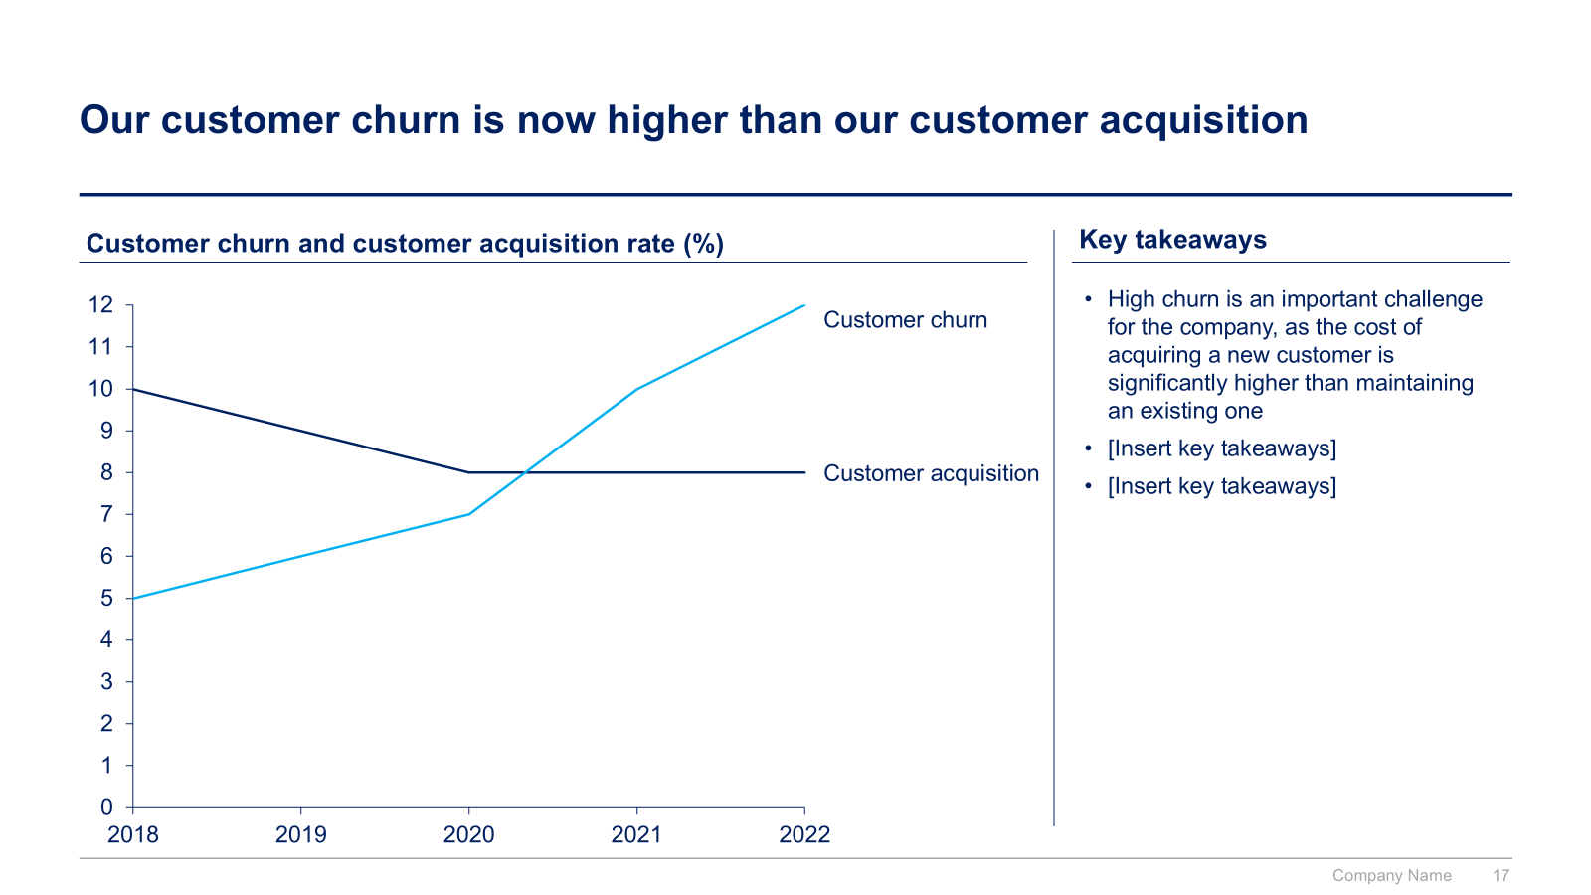
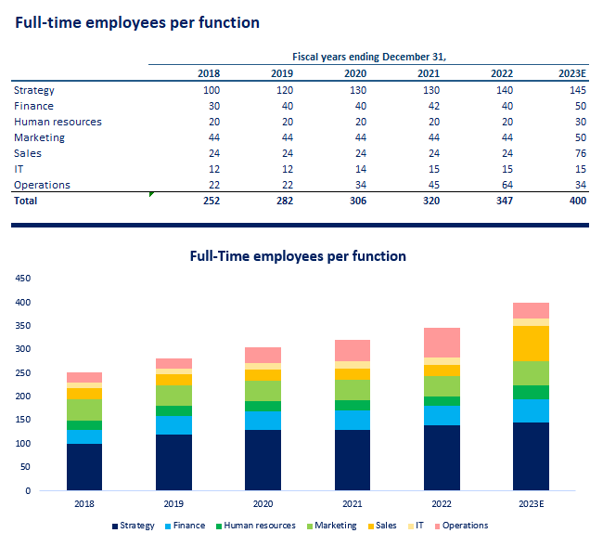
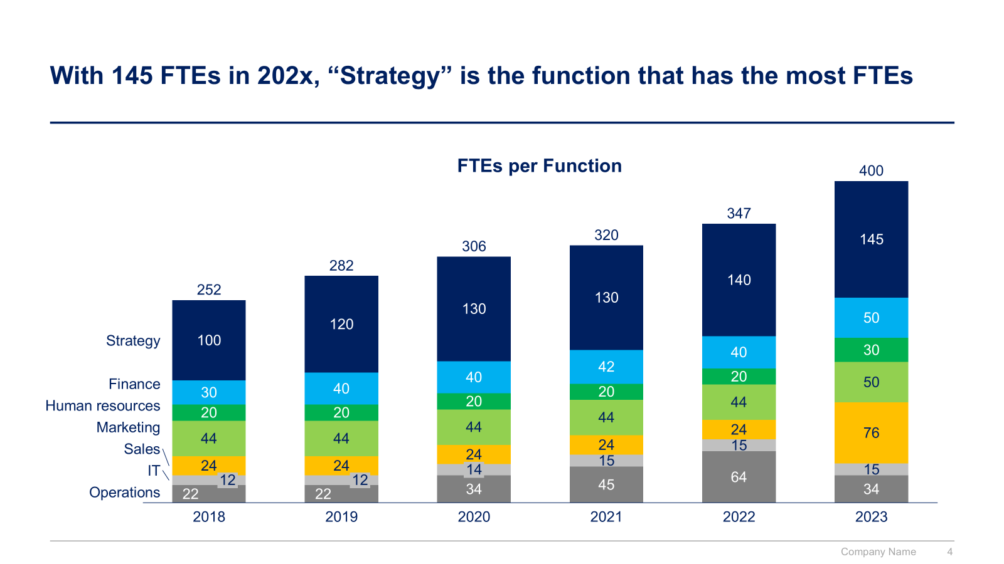
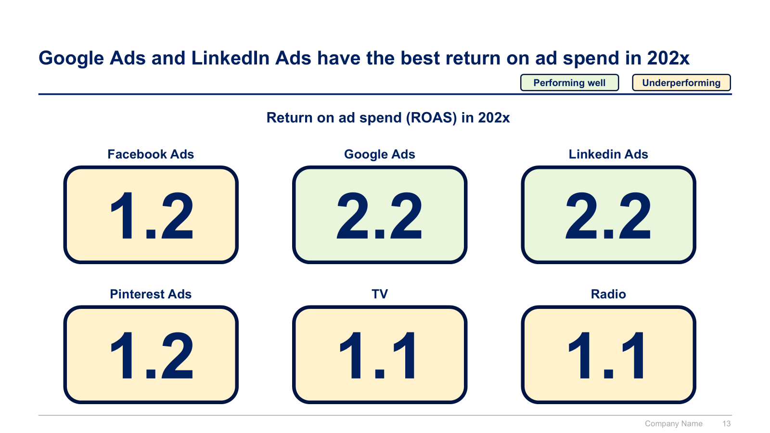
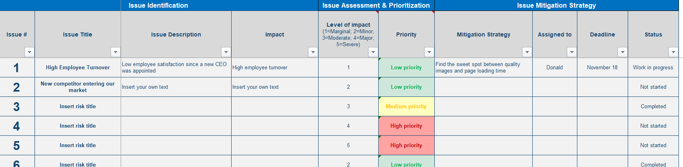
Functional Dashboards Small preview

Slide 8
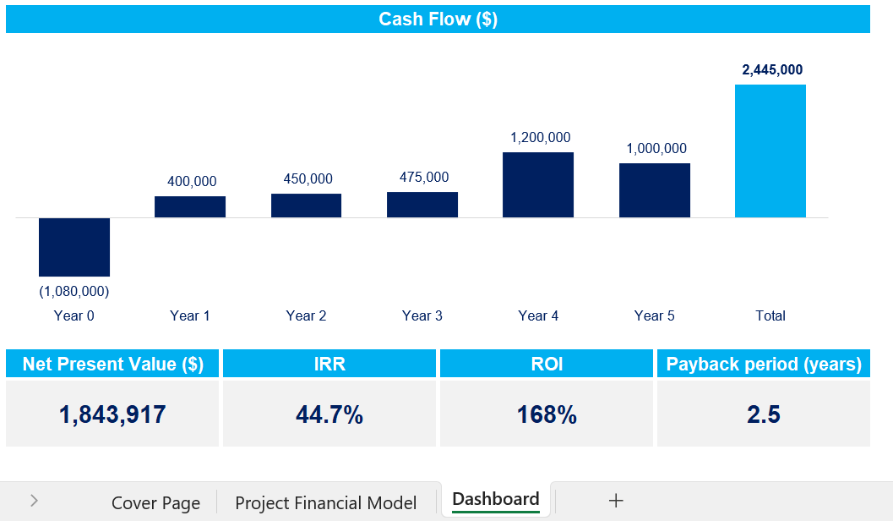
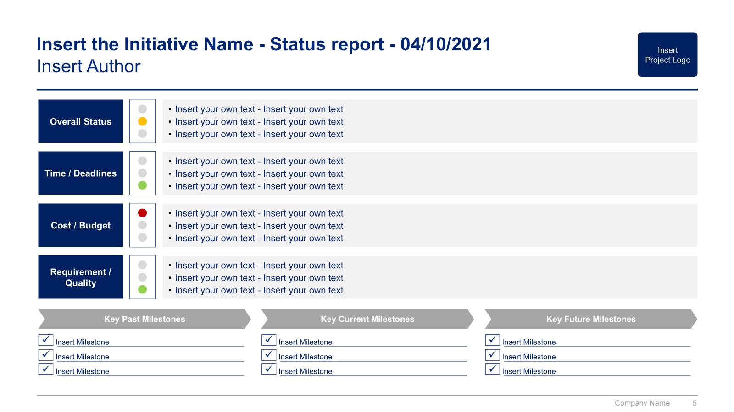
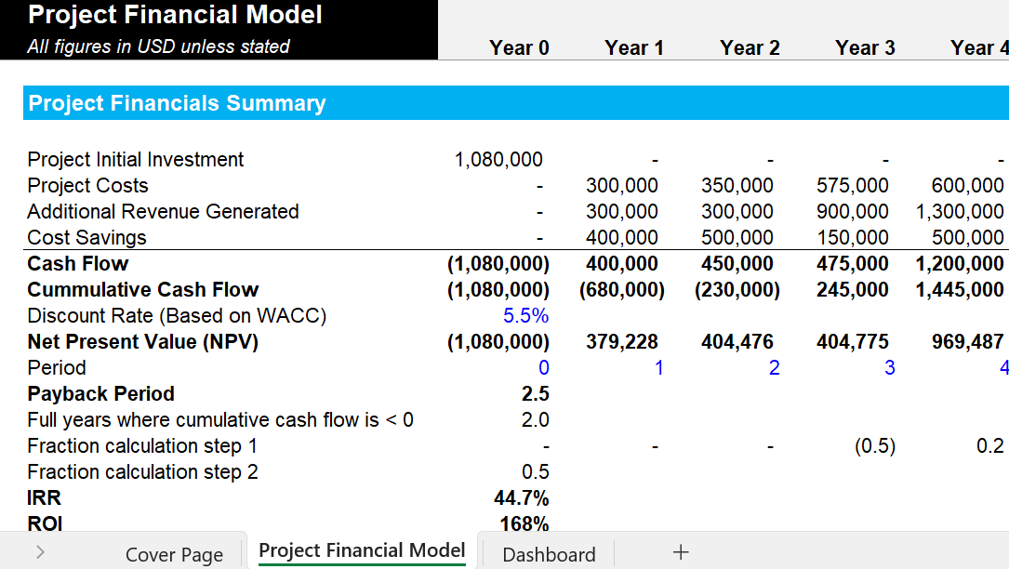
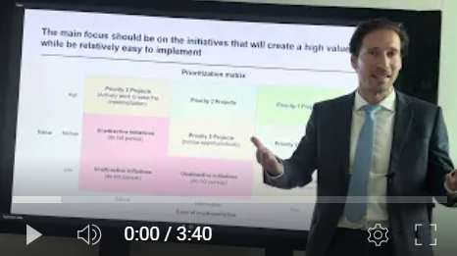
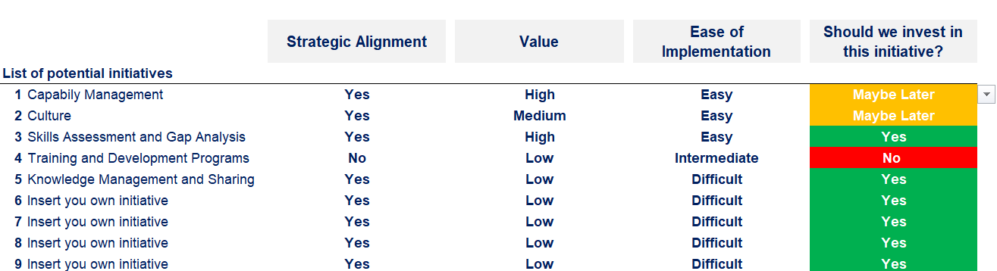
Project Dashboards Small preview

Slide 9
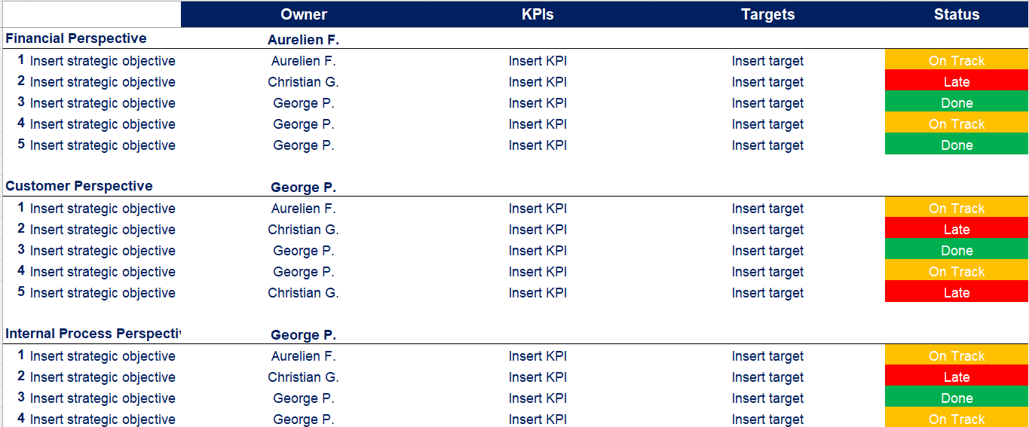
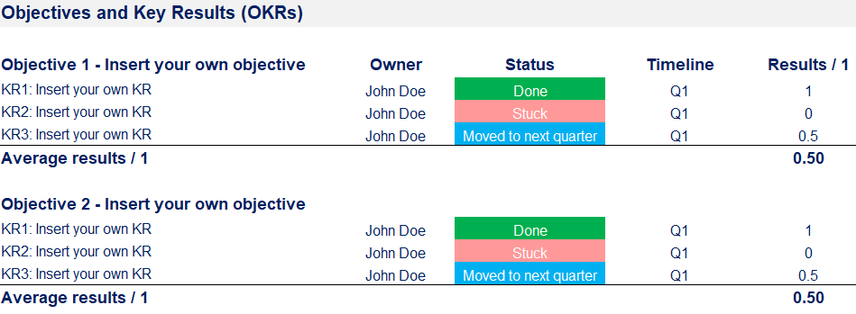
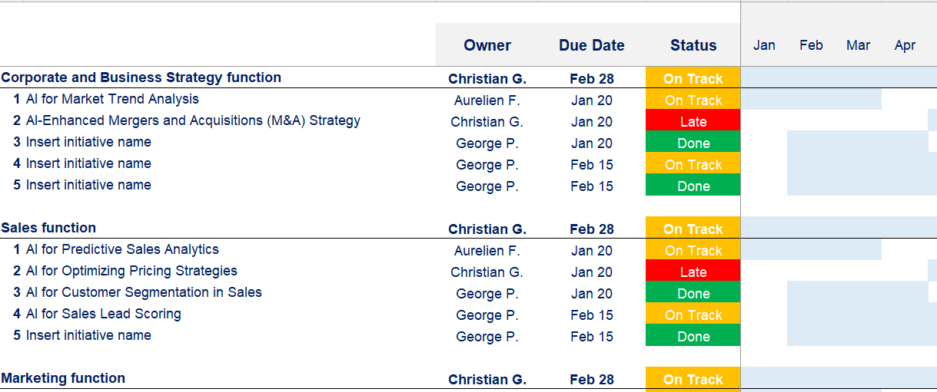
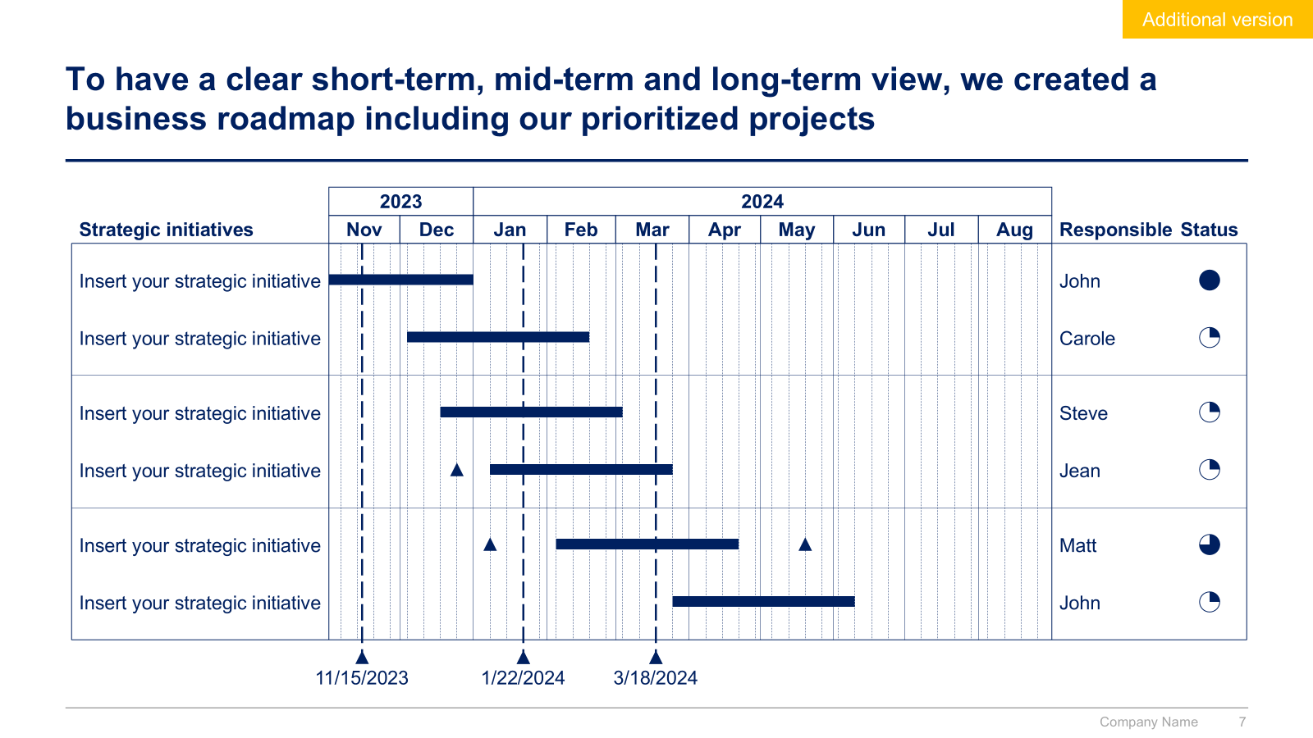
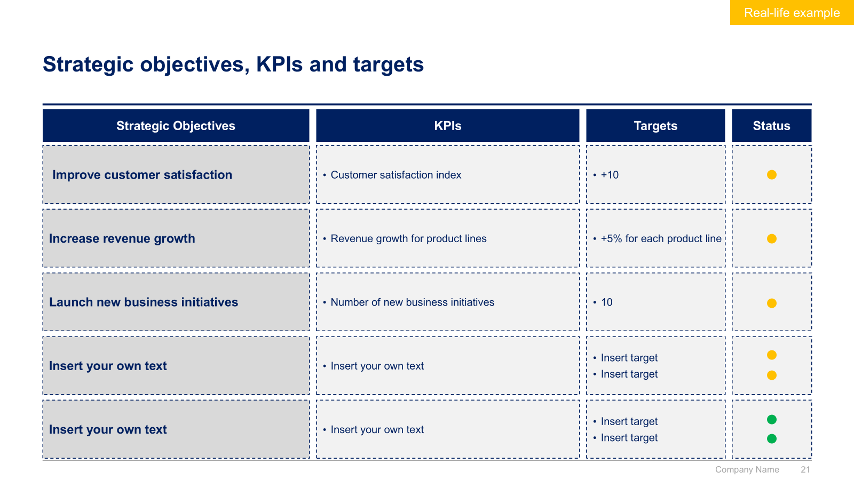
Strategic Plan and Business Roadmap Dashboards Small preview

Slide 10
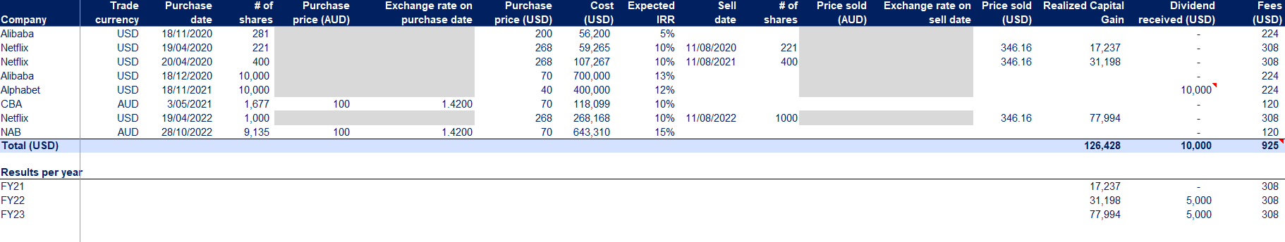
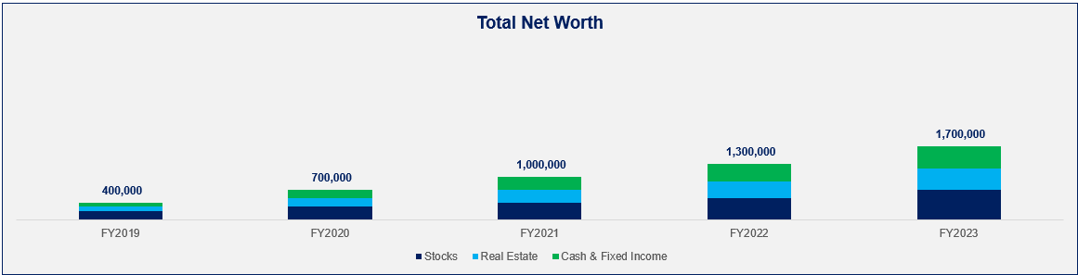
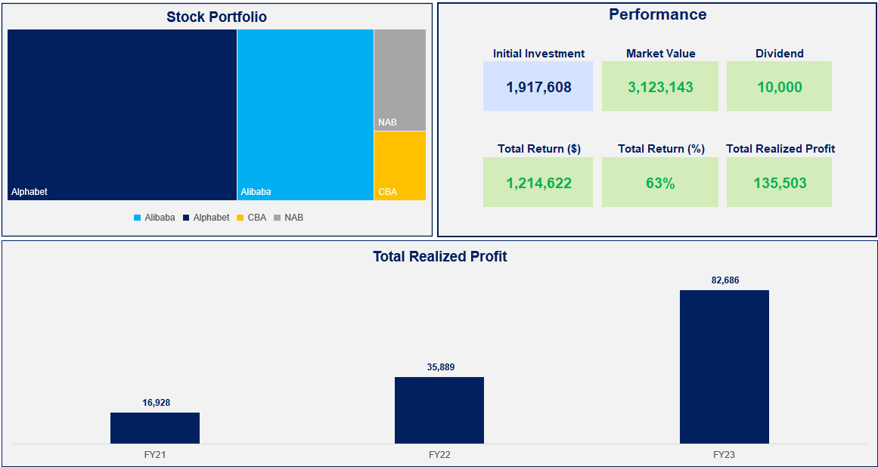
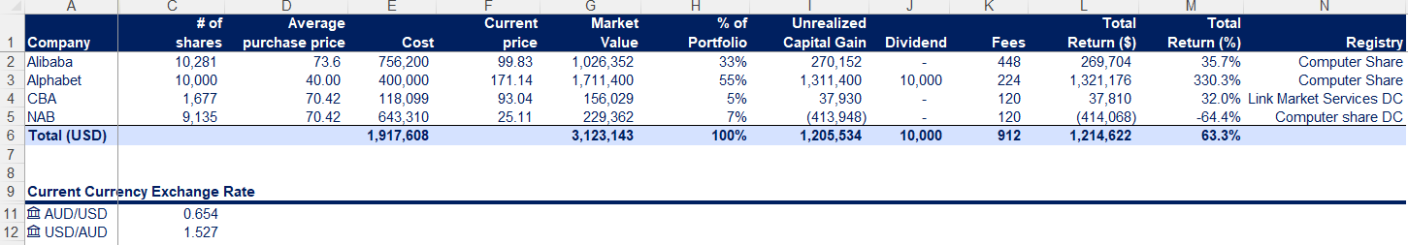
Stock Investment and Net Worth Dashboards Small preview

Slide 11









Our Management Consulting Toolkits include 9 key benefits
Improve the growth & efficiency of your organization by leveraging Management Consulting Toolkits created by ex-McKinsey, Deloitte & BCG Consultants.
Make a great investment for your career & organization. It cost us US$8M+ over the past 10 years to create all our Toolkits. Get them for a fraction of this cost.
Get a competitive advantage. It’s like hiring Management Consultants to create all the practical Frameworks, Tools & Templates you need.
Get the job done quicker and never start from scratch again with our ready-made and fully editable Frameworks, Tools & Templates in Powerpoint & Excel.
Don't reinvent the wheel. We have already worked 30,000+ hours over the past 10 years to create all the Management Consulting Toolkits you need.
Improve the capabilities of your organization by learning how the Fortune 100 and Global Consulting Firms do it.
Decrease your costs. Hiring tier-1 Consultants for a project would cost you $300k+. Way more expensive than our Toolkits, which will last you a lifetime!
Become your organization’s subject matter expert and impress your stakeholders with world-class approaches to resolve common business problems.
Get free support and advice from our ex-McKinsey, Deloitte & BCG Management Consultants.

Slide 12
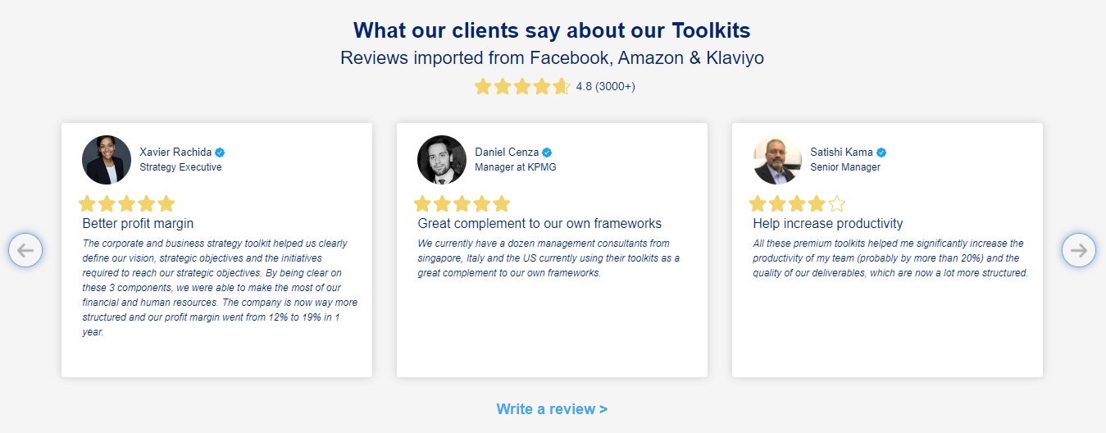
What our clients say about our Toolkits
Click here to see more reviews >

Slide 13






Join 200,000+ Executives, Consultants & Entrepreneurs leveraging our Toolkits to improve the performance of their organization
Trusted by small and large organizations
Customer satisfaction
4.8
Number of countries leveraging our Toolkits
160+
Number of professionals leveraging our Toolkits
200,000+
Daily rate of our ex-McKinsey, Deloitte and BCG Management Consultants
$3k-$4k

Slide 14

Interested in more than 1 Toolkit? Access all our Toolkits for half the price with our Gold Access
Gold Access
Click here to learn more

Slide 15


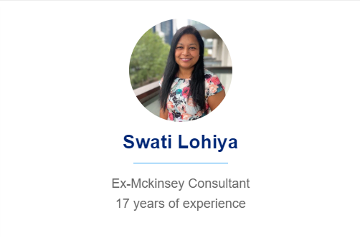



Need additional help? Send us a brief and we’ll find you the right talent from our network of 500+ tier-1 Management Consultants
Click here to send us a Project Brief

Slide 16

This was just a small preview.
www.domontconsulting.com

